Slide 1







Developer Survey 2024
Sambit Daspatnaik
2-Apr-2024

Slide 2



OUTLINE
Executive Summary
Introduction
Methodology
Results
Visualization – Charts
Dashboard
Discussion
Findings & Implications
Conclusion
Appendix

Slide 3

EXECUTIVE SUMMARY
Introduction - Objective and Data Context Setting
Data Analysis Methodology
Data Gathering
Data Wrangling
Data Exploration
Data Analysis
Data Visualization
Results with Graphical and Trend Analysis Support
Overall Findings - Discussion
Conclusion

Slide 4

INTRODUCTION
Objective:
Trends to understand the existing Development Stack and predict the future trends.
Developer characteristics across the globe.
Data is based on a comprehensive survey of developers across the globe.
Respondents in the range of 100,000.
Results are representative considering the World Techie population.

Slide 5

METHODOLOGY
Data Collection using web scraping, APIs
Data Wrangling to clean and enrich the data with missing values
Exploring & Analysing Data to understand data distribution, outliers & finding correlations
Data Visualization using different type of Charts & Plots
Build Dashboards to get a comprehensive view and ease of summarizing.

Slide 6

RESULTS

Slide 7
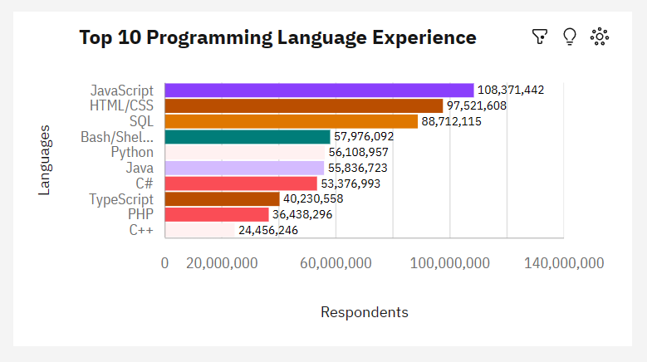
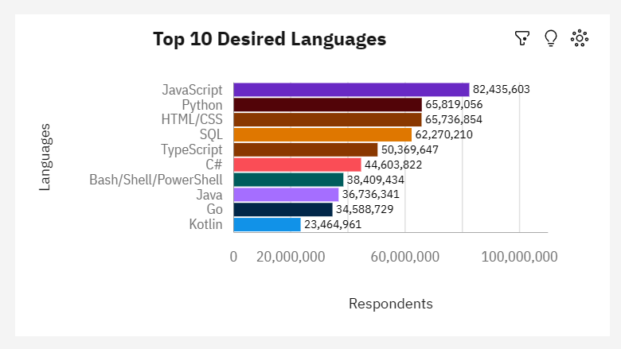
PROGRAMMING LANGUAGE TRENDS
Current Year
Next Year

Slide 8
PROGRAMMING LANGUAGE TRENDS - FINDINGS & IMPLICATIONS
Findings
JavaScript remains as the leading language.
Python has been growing fast and over taking other languages.
Bash/Shell/Powershell making its way to the top 10 trends in future.
Typescript has been gaining momentum.
Java has been losing its ranking.
Implications
Though Javascript still stays at the top, there has been reduced usage and possibly a migration from JavaScript to TypeScript.
Go and Kotlin are likely to be emerging as the next gen languages in upcoming future.

Slide 9
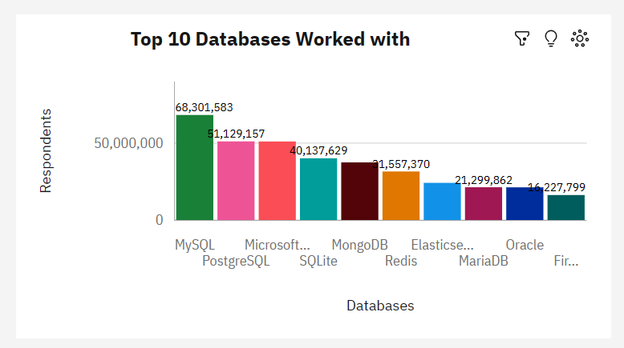
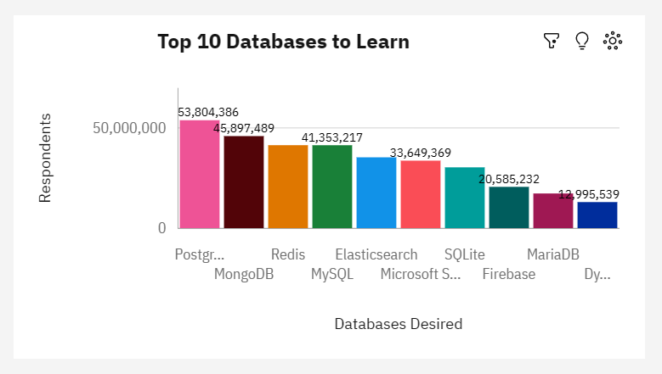
DATABASE TRENDS
Current Year
Next Year

Slide 10
DATABASE TRENDS - FINDINGS & IMPLICATIONS
Findings
PostgreSQL has moved to the number one DB.
MongoDB & Redis have moved up in the ladder.
Microsoft SQL and SQLite have moved down in the rankings.
Implications
Microsoft SQL Server and SQLite are losing their dominance in the market.
PostgreSQL and MongoDB are getting established in the market.

Slide 11

DASHBOARD (Link to Github)
IBM-Data-Analytics-Capstone-Project/Week 5 - IBM Cognos/Capstone Dashboard - IBM Cognos Analytics.pdf at main · dreamsamee/IBM-Data-Analytics-Capstone-Project (github.com)

Slide 12
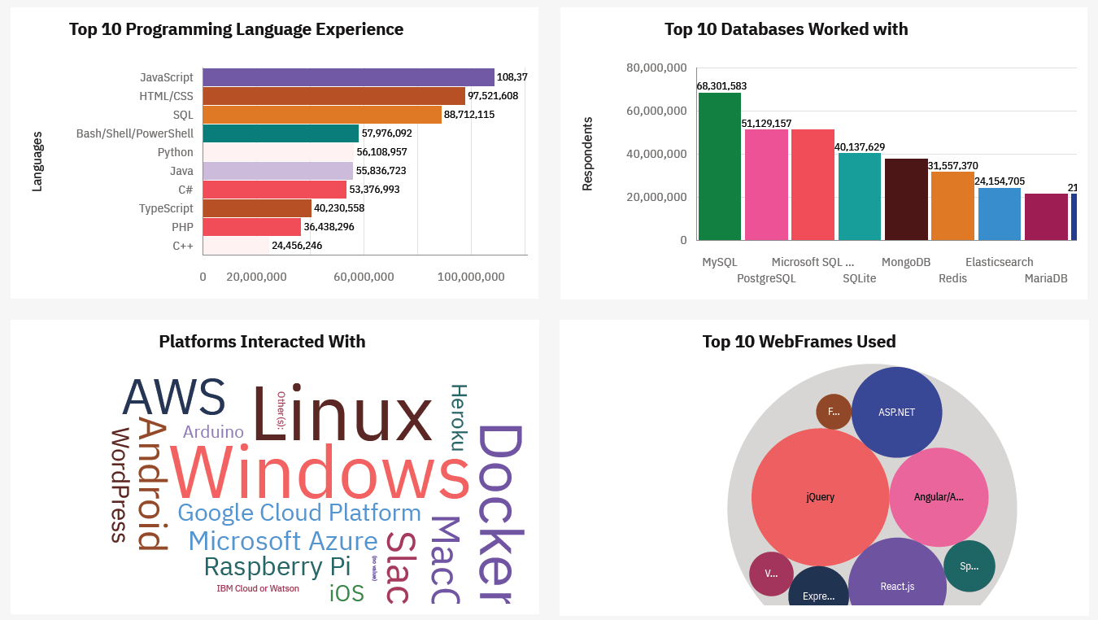
DASHBOARD TAB 1 – CURRENT YEAR

Slide 13
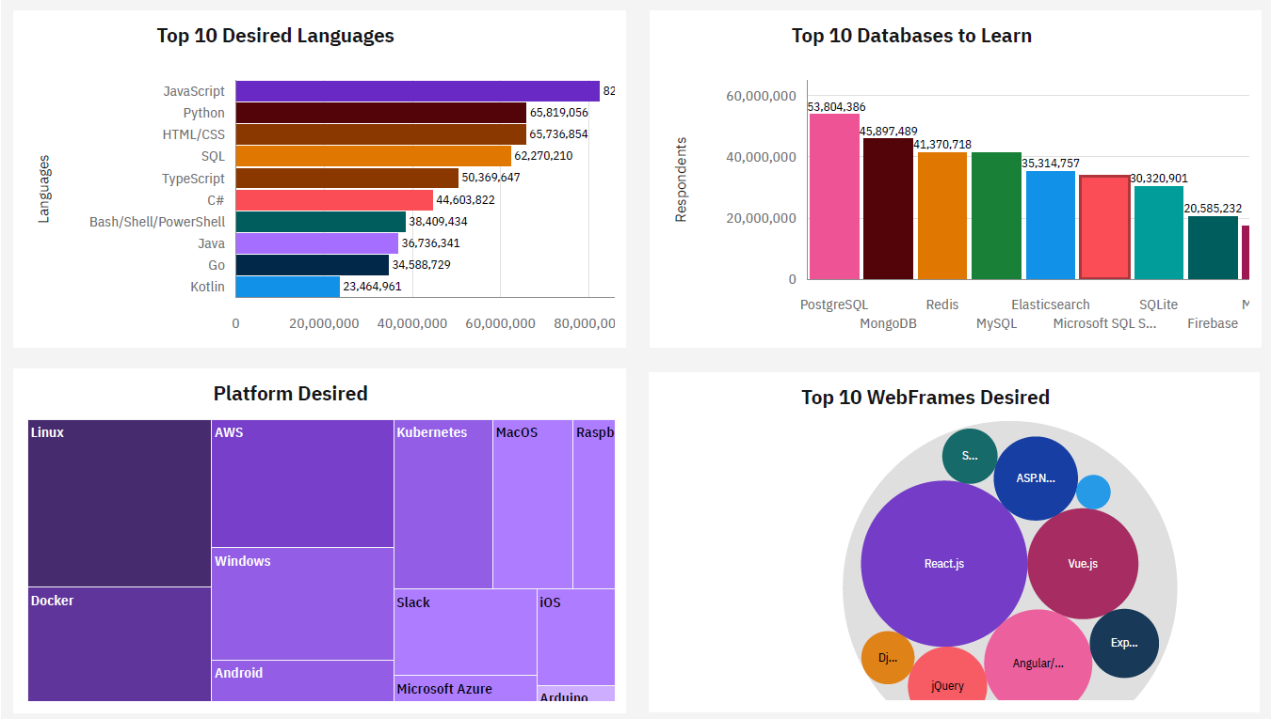
DASHBOARD TAB 2 - FUTURE

Slide 14
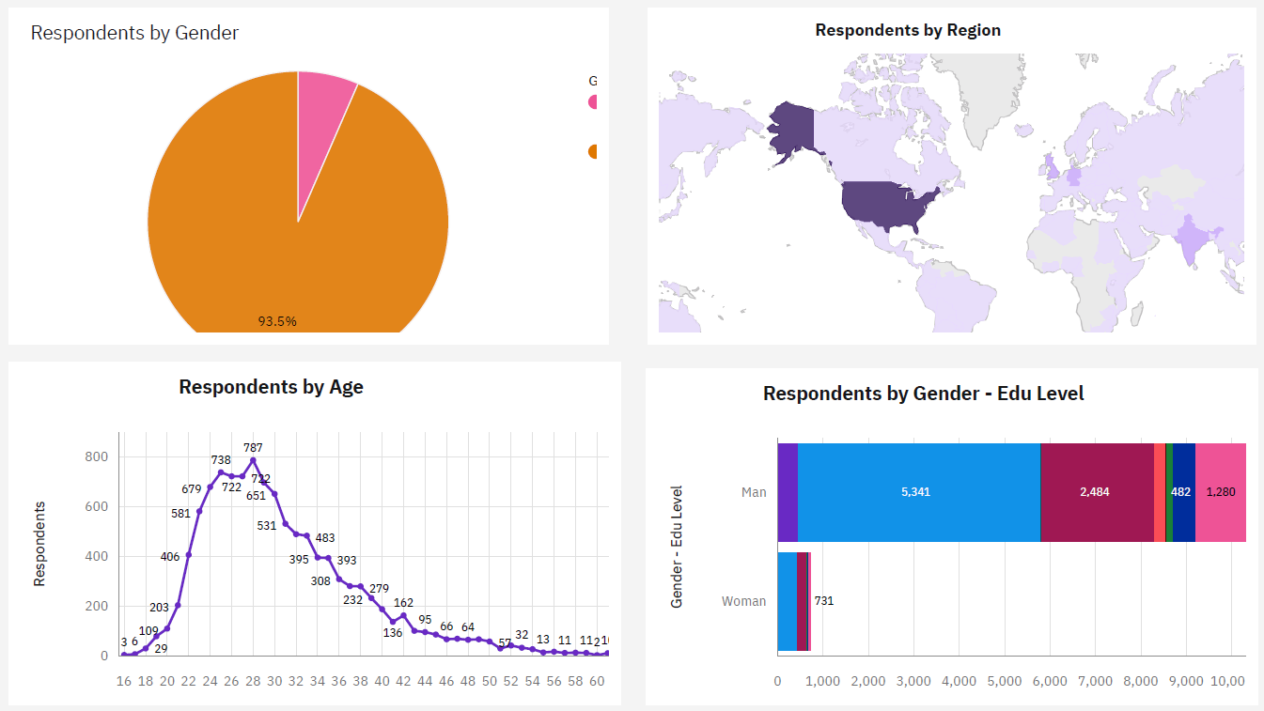
DASHBOARD TAB 3 - DEMOGRAPHICS

Slide 15
DISCUSSION

Slide 16
OVERALL FINDINGS & IMPLICATIONS
Findings
JavaScript widely used and TypeScript getting popular. Python gaining popularity.
PostgreSQL has moved to the number one DB.
MongoDB & Redis have moved up in the ladder.
Over 90% of the developers are male.
Developers are mostly located in developed countries.
Implications
JavaScript, Python, TypeScript & Jquery Web frame gaining followers.
Emerging technologies include Go and Kotlin.
In Databases, PostgreSQL and MongoDB are getting established in the market, while Microsoft SQL Server and SQLite are losing their dominance in the market.
Global polarization of Developers wrt location and gender.

Slide 17

CONCLUSION
While we see established programming languages and databases losing market, we also see new technology trends emerging.
A few programming languages and databases are gaining momentum & seem to top the charts in future.
Marked polarity of developers wrt gender and location.

Slide 18
APPENDIX

Slide 19
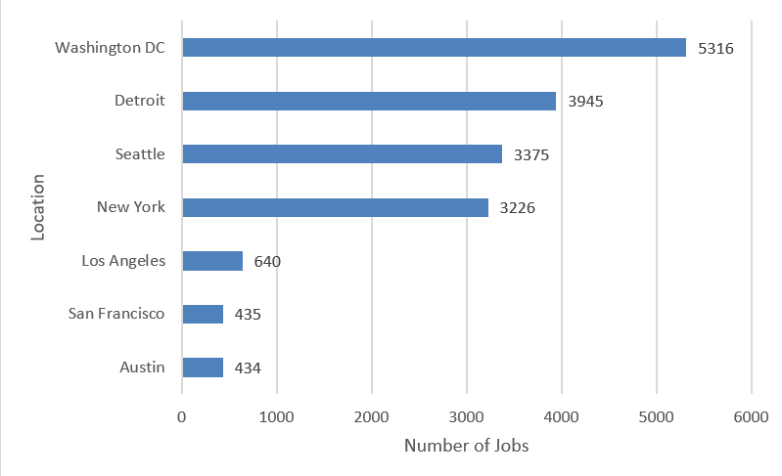
JOB POSTINGS

Slide 20
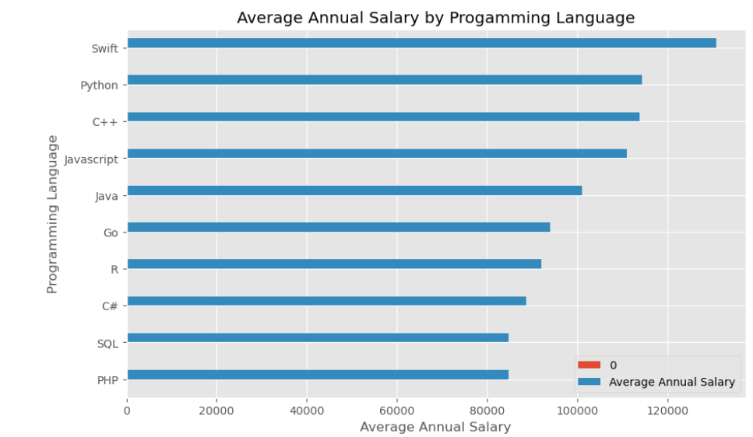
POPULAR LANGUAGES

